Slide 1



Slide 2
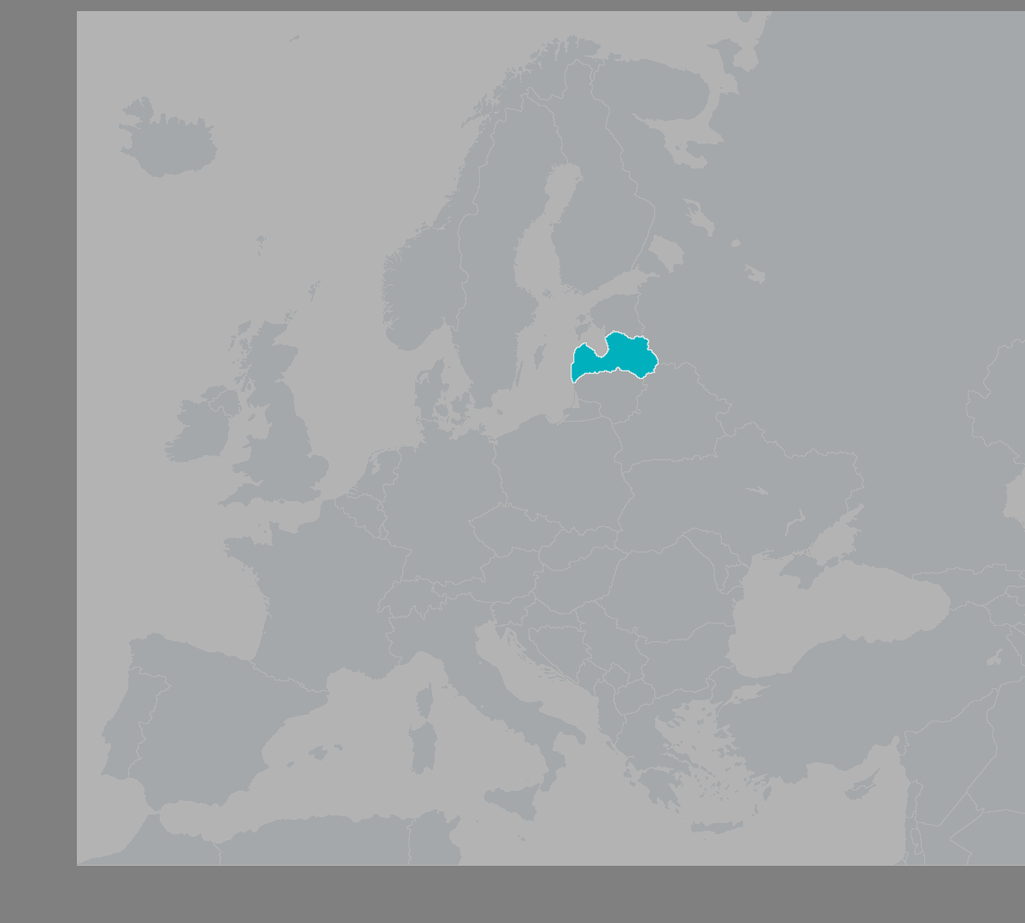
About Us
Activity: consumer lending (license no. NK-2017-007)
Company age: 9y 4m
Number of employees: 12
Product: line of credit
Competitive advantage: the payment card linked to the line of credit
Market: Latvia
Portfolio on 30.06.2025:
  Portfolio size (gross): EUR 5 690 000
  Portfolio size (net): EUR 5 360 000
  Number of clients: > 5000
  Cards issued: > 800
Latvia
Population 1.9m
Economically active citizens 940k
2024
Competitives: 35
Overall credit portfolio: 1200m EUR
Marketing cost per client: up to 100 EUR

Slide 3
Our Values
NordCard strives for a world in which every person has a chance to implement all intentions.
Our aim is to grant this chance by creating a stable and reliable financial product that provides excellent customer service.
CLIENT - With care and respect
We equally respect all our clients and are proud that
they have chosen NordCard
TRANSPARENCY - Without hidden rules
We honestly lay out all the rules governing our
collaboration and always inform about changes
TEAM - We like, what we do
A joint aim and joint interests make NordCard a
joint team
EXCELLENCE - Every detail is important
To provide impeccable product, we tirelessly work
on every detail
DEVELOPMENT - Our future is in development
We invest resources in ideas that perfect our product,
job, and ourselves
SECURITY - Collaboration relies on trust
We exclude all the risks that may arise to the safety
of our clients and business
,
,
We are proud of having created a product with excellent customer service that has managed
to attain our clients’ appreciation and that opens new opportunities for them to implement their wishes!

Slide 4

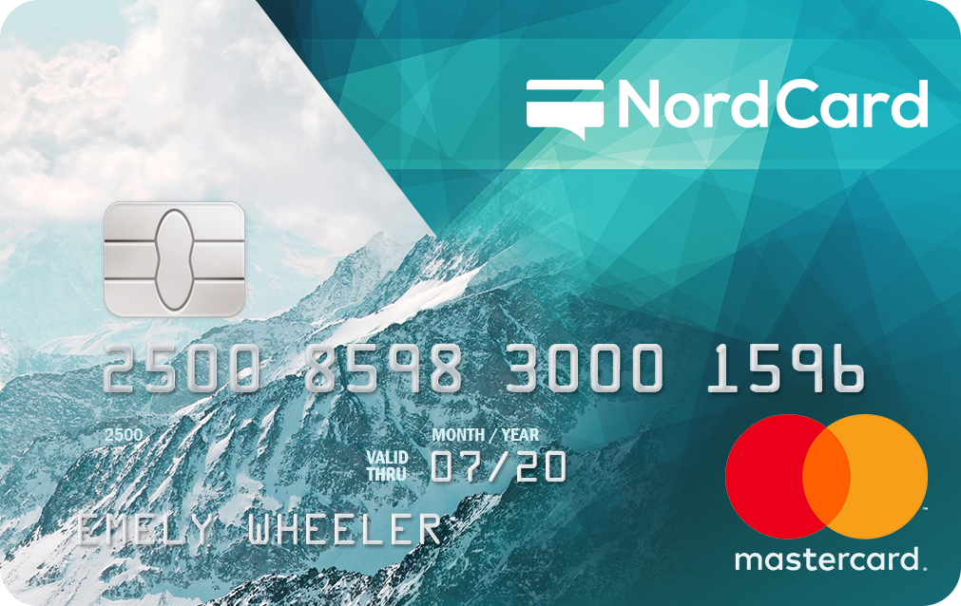
NordCard Creditlimit
Apply for NordCard Creditlimit just once but use it when and as often as you want. Open up new opportunities with NordCard!
Creditline up to 10 000 EUR
Repayment term up to 120 months
Payment card
Flexible repayment options
Online Banking system
Individual scoring process and unique offers
NordCard Creditlimit Is Always by Your Side
Keep track of your card transactions in Online Banking system
Receive your card free of charge by post
Withdraw money from ATMs and pay around the world
Shop online safely

Slide 5

How Our Clients Apply
1
Fill in our simple one-step application form
Less than 15-field online-application form makes the application
process very easy, transparent and fast
Customers choose us because we are:
RELIABLE 130 900
People chose NordCard
PROFESSIONAL 200
Answered questions per day
EASY 1.5 min
To fill in an application form
EFFECTIVE 97%
Answers provided within the first minute of a conversation with a consultant
Mandatory Requirements:
Customers in the 18-75-year-old age group
Official net income starting from 270 EUR per month
Personal bank account in one of the banks of Latvia
Declared address in the Republic of Latvia
2
Confirm registration
Transfer of 0.01 EUR from private bank account to the NordCard bank account assures the required level of Online identification
3
Get scored and get a loan
We make quick yet profound processing of applications and
scoring of each new customer, making AML/KYC, Income/Spendings, Credit History/Debt and other important checks

Slide 6

Customer Profile
Product Statistics
Female 44% / Male 56%
Average age 39
Average income 790 EUR
3 most popular industries
  Manufacturing
  Retail and wholesale
  Government
Higher education 47 %
NordCard payment card 20 %
Average Creditlimit amount 900 EUR
Utilization rate 77%
Average repayment age 700 days
One-time loan 40% / Constant creditline use 60%
Debt rate 9%
Default rate 8%
3 most popular spending categories
  Consumer goods
  Home repair
  Car purchase or repair

Slide 7

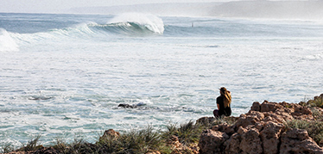

How Our Clients Use the Product
As a short-term loan
As money reserves
As a long-term loan
Suited for people who want to borrow in the short term. It is advantageous, fast, and don’t charge a loan extension fee
Use a credit line like money reserves that are always available to cover both unexpected and desired spending
There is always an option of repaying the loan over a longer period, and thus benefit from flexible repayment options
Apply just once, but use when needed
Have benefits of interest-free period
Return in the long term and forget about paying extension fees
Apply now, but use when you want
Start to repay, only when start to use it
No fee for account opening and maintanance
Pay a loan within 60 month
Divide repayment in smaller parts
With each payment interest gets smaller

Slide 8
Business Model
mastercard
payments all over the world
ATM cash withdrawals
secure online payments
payment card
self service
invocing
account statement
communication
profile settings
payments
notification settings
paid-service administration
brand
marketing & SEO
online applications
FAQ
online
banking
web
NordCard
technology driven approach
extensive automation
“All-in-Online” principle
fully integrated infrastructure
FinTech
customer service
applications (AML, KYC, scoring)
professional customer service
debt collection

Slide 9
Portfolio
PORTFOLIO ON 31.12.2024 (EUR)
Position | Total | Base | Interest | Fees | Penalties | Clients
WITHOUT DELAY | 2 433 863,38 € | 2 343 792,43 € | 78 869,65 € | 11 201,28 € | 0.02 € | 3 124
SOFT COLLECTION (1 – 30 delayed days) | 296 795,73 € | 273 252,04 € | 18 527,13 € | 4 941,83 € | 74,73 € | 220
HARD COLLECTION (31 – 90 delayed days) | 102 462,64 € | 90 381,51 € | 8 925,32 € | 2 704,56 € | 451,25 € | 78
COLLECTION GRAPH | 89 445,98 € | 63 096,17 € | 8 300,08 € | 962,73 € | 17 087,00 € | 75
INCASSO 1st WASH | 308 963,31 € | 249 490,27 € | 45 766,25 € | 11 059,92 € | 2 646,87 € | 218
FINAL COLLECTION P1 | 191 805,50 € | 128 640,21 € | 34 843,56 € | 12 587,03 € | 15 734,70 € | 118
INCASSO 2nd WASH | 193 185,05 € | 133 179,43 € | 28 463,37 € | 8 555,23 € | 22 987,02 € | 107
FINAL COLLECTION P2 | 686 311,92 € | 434 719,89 € | 113 296,85 € | 50 532,33 € | 87 762,85 € | 415
COURT (WARNING) | 228 237,62 € | 128 833,02 € | 38 640,62 € | 18 898,43 € | 41 865,55 € | 183
COURT (ORDINARY) | 500 909,44 € | 263 597,95 € | 88 408,48 € | 60 955,01 € | 87 948,00 € | 270
INSOLVENCY | 46 514,08 € | 31 388,86 € | 7 518,04 € | 1 300,05 € | 6 307,13 € | 30
DECEASED | 67 150,02 € | 51 779,90 € | 10 131,89 € | 1 191,69 € | 4 046,54 € | 57
READY FOR CESSION | 62 038,69 € | 27 593,01 € | 11 532,10 € | 10 810,79 € | 12 102,79 € | 81
Total | 5 207 683.36 € | 4 219 774.69 € | 493 223.34 € | 195 700.88 € | 299 014.45 € | 4976
Court and Incasso’s portfolio
Our €5.2 million portfolio as of December 31, 2024, remains effective despite a higher proportion of court-related or incasso-related debts. Strong recovery efforts resulted in €37,804 from court cases and €20,897 from Incasso activities in May and June, demonstrating our ability to generate positive outcomes in challenging situations. With €2.43 million of debt managed without delays and consistent progress across all stages, we are efficiently recovering outstanding amounts, minimising risks, and driving solid returns for investors.

Slide 10
Monthly Cash flow
MONTHLY CASH FLOW | CURRENT PORTFOLIO | EXPECTED (10M NET PORTFOLIO)
INCOME
INTEREST | 87 461.51 | 191 838.68
FEES | 29 175.59 | 64 764.87
LATE PAYMENT PENALTIES | 542.47 | 4 674.08
OTHER PENALTIES | 1 524.54 | 2 081.59
OTHER INCOME | 18.27 | 1 717.34
TOTAL INCOME | 118 722.38 | 265 076.56
PRODUCTION EXPENSE
DIGITAL MARKETING | - 349.32 | - 1 141.75
EMAIL MARKETING | - 761.42 | - 1 077.39
AFFILIATES FEES | 177.84 | - 727.06
CREDIT INTERMEDIARIES' FEES | - 2 510.27 | - 5 072.00
REGISTERS AND DATABASES | - 2 223.98 | - 2 804.87
DEBT COLLECTION EXPENSES | - 5 431.87 | - 7 052.83
CARD MANUFACTURING, DELIVERY | - 3 092.59 | - 3 831.43
INTEREST EXPENSE | - 44 330.52 | - 69 744.22
NPL WRITE-OFFS | - 1 141.73 | - 5 035.21
TOTAL PRODUCTION EXPENSE | - 61 019.54 | - 96 486.76
ADMINISTRATIVE EXPENSE
CALL CENTER SALARIES | - 16 552.42 | - 18 813.54
ADMINISTRATION SALARIES | - 15 801.80 | - 30 670.90
OTHER HR AND ADMINISTRATION COSTS | - 3 581.42 | - 4 097.05
INTERNET, EMAIL, TICKETING AND SMS | - 3 175.85 | - 3 626.72
IT WORKS, INTEGRATIONS | - 1 812.46 | - 3 628.30
RENT, UTILITIES, MAINTENANCE | - 1 900.39 | - 1 990.25
LICENSE MAINTENANCE | - 4 583.33 | - 4 583.33
BANK COMMISSSIONS | - 672.37 | - 805.89
TOTAL ADMINISTRATIVE EXPENSE | - 49 080.04 | - 68 215.98
PROFIT BEFORE TAXES | 10 622.80 | 100 373.82

Slide 11
Assets
ASSETS (expected) | 31.12.2024 | 31.12.2023
LONG-TERM INVESTMENT | EUR | EUR
INTANGIBLE INVESTMENTS
CONCESSIONS, PATENTS, LICENCES, TRADEMARKS | 170 389 | 182 108
OTHER INTANGIBLE INVESTMENTS | 2 894 | 3 441
TOTAL INTANGIBLE INVESTMENTS | 173 283 | 185 549
FIXED ASSETS
OTHER FIXED ASSETS AND INVENTORY | 17 333 | 21 393
TOTAL FIXED ASSETS | 17 333 | 21 393
TOTAL LONG-TERM INVESTMENT | 190 616 | 206 942
CURRENT ASSETS
INVENTORY
RAW MATERIALS AND CONSUMABLES | 6 343 | 2 216
TOTAL CURRENT ASSETS | 6 343 | 2 216
DEBTORS
RECEIVABLES | 4 941 549 | 4 173 610
OTHER DEBTORS | 4 641 | 14 198
COSTS OF FUTURE REPORTING PERIODS | 64 985 | 58 101
TOTAL DEBTORS | 5 011 175 | 4 245 909
CASH AND CASH EQUIVALENTS
CASH EQUIVALENTS | 69 304 | 69 891
TOTAL DEBTORS | 5 086 822 | 4 318 016
TOTAL ASSETS | 5 277 438 | 4 524 960
Intangible investments
Intangible investments include trademarks, IT infrastructure, and consumer lending licenses. The license acquisition cost is €250,000, and the fair value of the IT infrastructure is approximately €200,000. Thus, the market value of these assets significantly exceeds the €173,283 book value.
1
Fixed assets
Fixed assets include office equipment, servers, and a complete workplace setup, with a book value of €17,333. The company also has a full remote-enabled setup for 20 employees, each valued at about €1,500. Therefore, the market value of the fixed assets exceeds their book value.
2
Debtors
We have updated our provision policy to align more closely with the current situation by linking it to the debt collection stage. As of December 31, 2024, receivables include a gross loan portfolio of €4,941,549 with provisions of €259,206. Other debtors comprise deposits for office-related expenses. For comparison, as of December 31, 2023, the gross loan portfolio totalled €4,412,353, with provisions of €238,743. This change ensures a more accurate reflection of portfolio risk and recovery potential.
3

Slide 12
Liabilities
LIABILITIES | 31.12.2024 | 31.12.2023
OWN CAPITAL | EUR | EUR
FIXED CAPITAL | 3 375 000 | 3 375 000
RETAINED EARNINGS
ACCUMULATED PROFIT/LOSS FOR THE PREV. YEARS | (1 622 376) | (1 706 310)
PROFIT OR LOSS OF THE REPORTING YEAR | 15 785 | 83 934
TOTAL OWN CAPITAL | 1 768 409 | 1 752 624
CREDITORS
LONG-TERM CREDITORS
OTHER LOANS | 3 369 347 | 2 696 376
TOTAL LONG-TERM CREDITORS | 3 369 347 | 2 696 376
SHORT-TERM CREDITORS
DEBTS TO SUPPLIERS AND EMPLOYEES | 11 241 | 20 977
TAXES AND STATE SOCIAL INSURANCE CONTR. | 14 649 | 15 522
OTHER CREDITORS | 24 753 | 23 790
ACCRUED LIABILITIES | 89 039 | 15 671
TOTAL SHORT-TERM CREDITORS | 139 682 | 75 960
TOTAL CREDITORS | 3 509 029 | 2 772 336
TOTAL LIABILITIES | 5 277 438 | 4 524 960
1
Fixed capital
The company's fixed capital is €3,375,000. In 2019, fixed capital was increased from €425,000 to €3,375,000 to lower costs.
2
Retained earnings
The accumulated loss over the past five years is €1,622,376. FY 2023 closed with €83,934, and FY 2024 closed with €15,785.
3
Creditors
We have partnered with Iuvo-Group and Bondster, crowdfunding companies, to repay short-term creditors and secure working capital for portfolio growth. In 4 years, we raised €3,369,347 through crowdfunding.
4
Total liabilities
Total liabilities are €5,277,438, where €1,768,409 is own capital, €3,369,347 are long-term creditors, and only €139,682 are short-term creditors. Therefore, the company has a high liquidity ratio.

Slide 13
Profit/Loss Statement
PROFIT AND LOSS STATEMENT | 2024 | 2023
 | EUR | EUR
NET TURNOVER | 1 361 468 | 1 175 257
COST OF PRODUCTION | (451 357) | (515 911)
GROSS PROFIT OR LOSS | 910 111 | 659 346
SALES SCOTS | (57 389) | (40 796)
ADMINISTRATION COSTS | (275 612) | (307 970)
OTHER OPERATING INCOME | 70 455 | 98 698
OTHER OPERATING EXPENSES | (264 930) | (127 068)
OTHER INTEREST INCOME | 172 | 201
INTEREST AND SIMILAR COSTS | (367 023) | (198 476)
PROFIT OR LOSS BEFORE CORPORATE TAX | 15 785 | 83 935
CORPORATE INCOME TAX FOR THE PERIOD | - | -
PROFIT OR LOSS AFTER CORPORATE INCOME TAX | 15 785 | 83 935
PROFIT OR LOSS FOR THE REPORTING YEAR | 15 785 | 56 273
1
Gross profit/loss
Gross profit remained strong despite the debt sale of €284,582 in May 2024. Following the sale, enhanced debt collection strategies helped maintain profitability and revenue stability from the remaining €5.2 million portfolio.
2
Sales, administration, interest and other expense
Sales, administration, and interest costs were carefully controlled. Operational efficiency has been maintained to offset expenses, ensuring profitability remains intact even as operational costs grow in line with expanding collections.
3
Cession (Portfolio Sale)
In May 2024, we sold €284,582 from the portfolio. This sale provided immediate liquidity, which we reinvested into improving debt recovery strategies, including court warnings and other methods, to strengthen future collection efficiency.
Profit and loss
Despite the cession, profitability remains positive. In May and June, we recovered €37,804 from court cases and €20,897 from Incasso activities, ensuring that the portfolio continues to deliver strong financial performance.
4

Slide 14
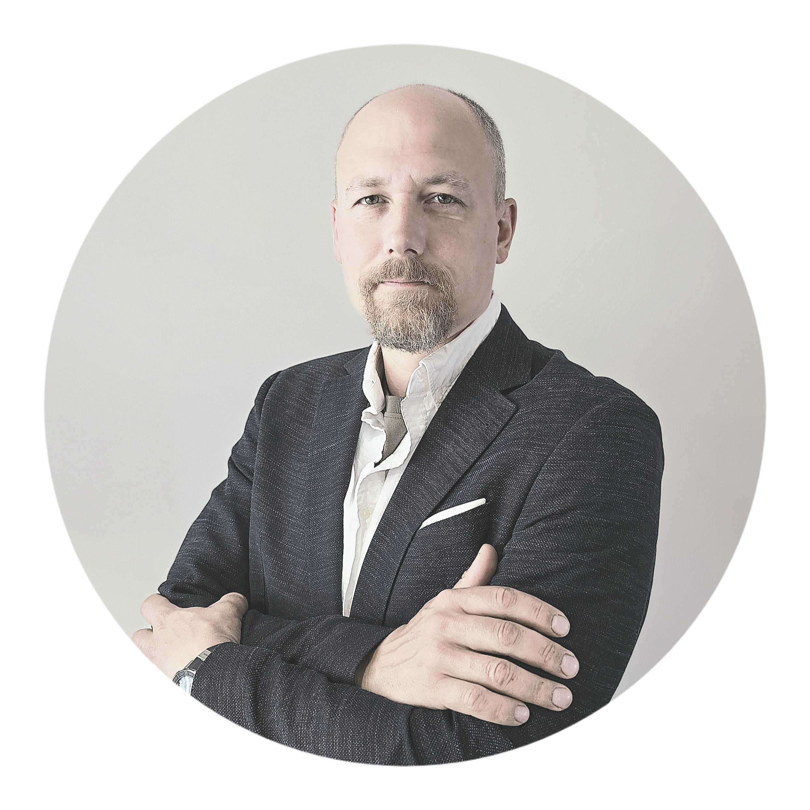
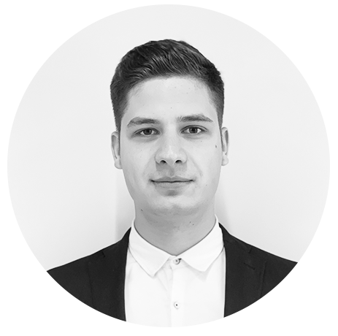
Management Team
Executive manager with
varied experience in
business development, finance, economics, jurisprudence, IT and operations management.
M.Econ. from the University of Latvia
B.Fin.Eng. from Riga Technical University
economics lecturer
CAMS certified
Business entrepreneur with over 20 years experience in
business management and varied experience in strategic planning, finance and operations in the banking and brokerage industry.
M.Econ. from Riga Technical University B.Econ. from Riga Technical University
Edgards Ivanovs
Shareholder
Daniels Jukna
Board member
CEO

Slide 15
Organizational Structure
Board
CEO
CEO
CIO
CFO
Debt Collection Department
Legal Department
Office and HR Department
Customer Service Department
IT Department
Marketing Department
Accountancy Department

Slide 16
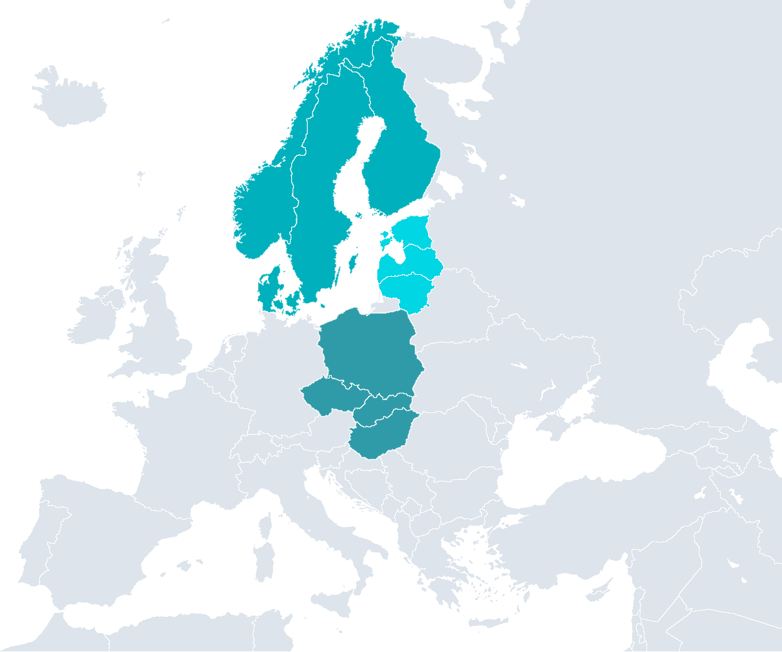
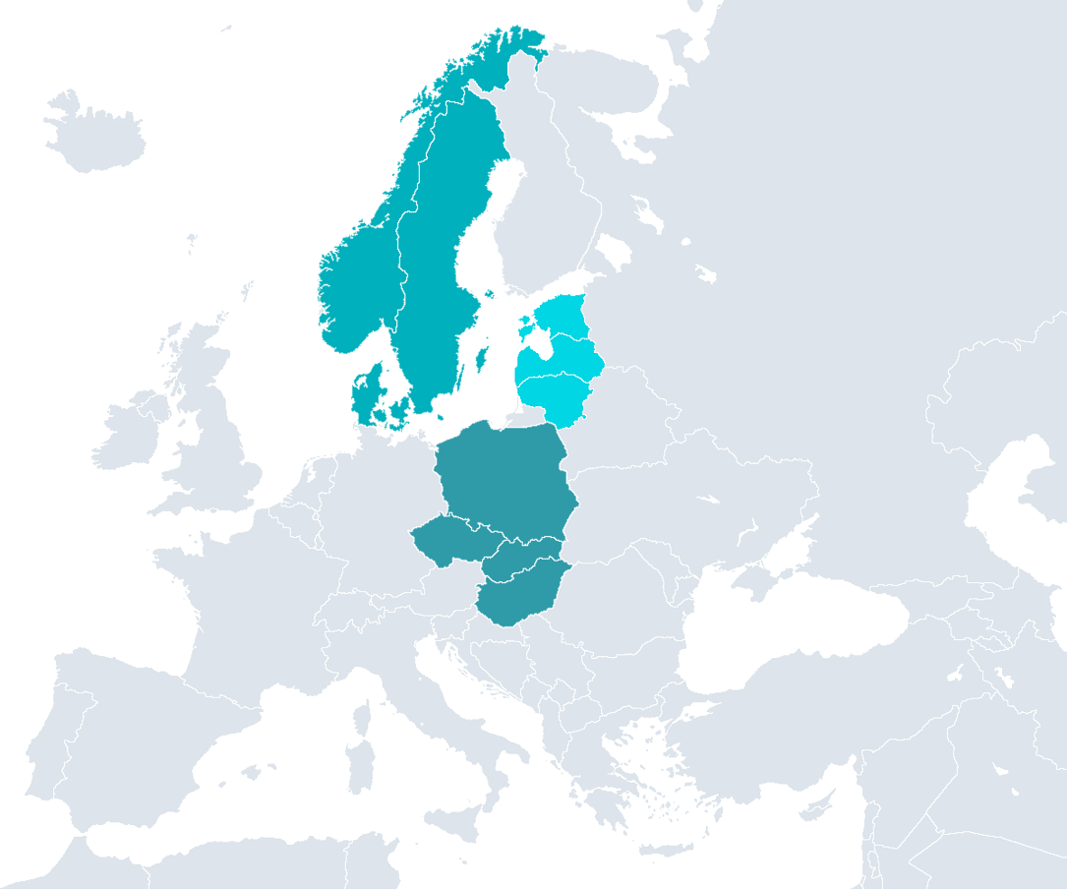
Future Scale Up
Scandinavia
Population 21m
Neobanking is simple
Expand business to other EU countries
Product with core banking services
Mobile APP
3m clients
1m payment cards
Infrastructure scale up and maximum automation
Baltics
Population 6m
Visegrád Four
Population 64m

Slide 17
Timeline
2017Q2
New product «Credit limit to account"
2016Q3
First NordCard card issued
2019Q3
New Online Banking system
2020Q3
New marketing channels
2021Q2
Joining Bondster platform
2017Q1
Great marketing campaign (TV, radio, internet)
2018Q2
Great improvement of scoring and debt collection processes
2019Q2
Introduction of new and more functional card
2016Q2
License obtained
2020Q1
Joining Iuvo platform
2020Q4
New product «Refinancing"
2016
2017
2018
2019
2020
2021
Gross total debt
350k
1.8m
2.2m
2.3m
2.2m
2.8m
Accumulated credit limit
350k
1.5m
1.7m
1.7m
1.7m
2.3m
2020Q1
Audit
2021Q1
Audit

Slide 18
Timeline
2023Q4
CarBuy platform
2025Q1
Great marketing campaign
2022Q3
Lenders
2025Q4
Joining CrowdedHero
2026Q4
New market
2027Q2
New market
2022Q2
Incoming transactions automatization
2023Q2
Joining Decamel
2025Q2
Evaluation automatization
2026Q1
Joining Mintos
2024Q1
Bank payments automatization
2025Q3
E-lizings platform
2022
2023
2024
2025
2026
2027
Gross total debt
3.5m
4.4m
5.2m
6.5m
9m
15m
Accumulated credit limit
2.8m
3.6m
4.2m
5m
7m
10m
2022Q1
Audit
2023Q1
Audit
2024Q1
Audit
2025Q1
Audit
2026Q1
Audit
2021Q1
Audit

Slide 19
Hedge Capital Company LLC
Skanstes street 25, Riga, LV-1013, Latvia
e-mail: info@nordcard.eu
phone: 00 371 62004400
www.nordcard.eu

