Slide 1



Slide 2
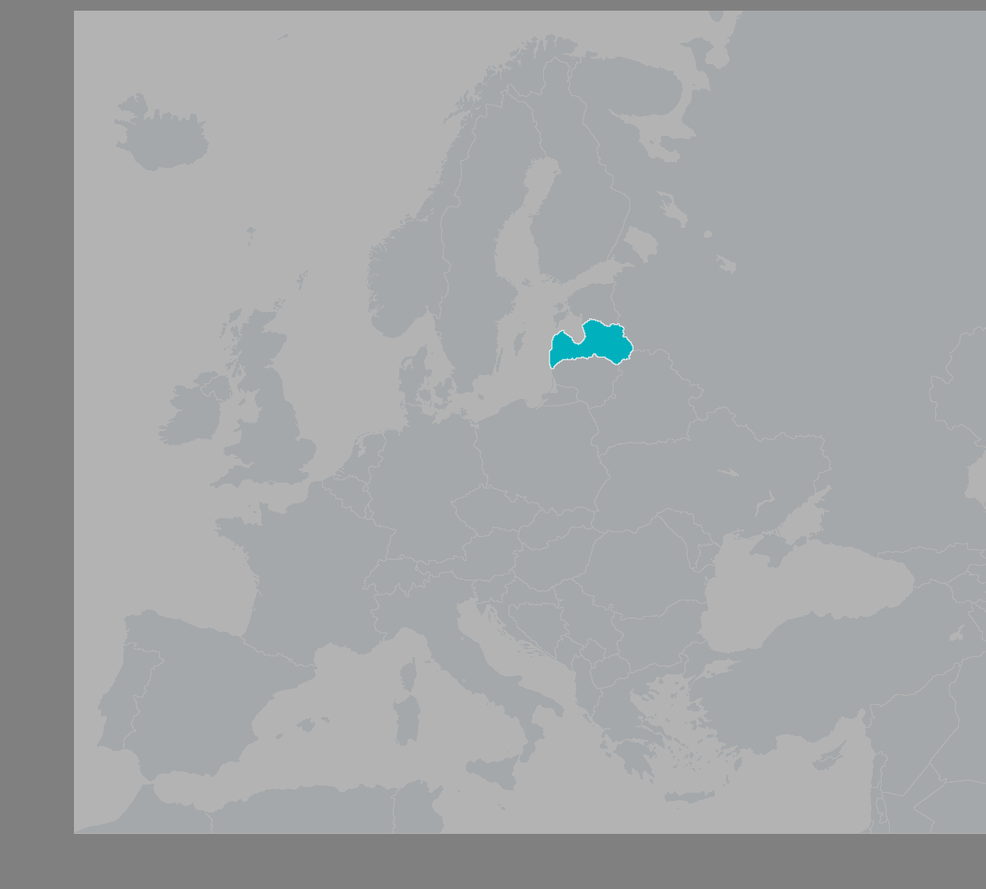
About Us
FinTech lending company
On the market since 2016
13 employees
200k online applications
4600 active clients
3.8m EUR credit portfolio
4 cycles of product development
Latvia
Population 1.9m
Economically active citizens 950k
2022
Competitives: 37
Overall credit portfolio: 890m EUR
Marketing cost per client: up to 100 EUR

Slide 3
Our Values
NordCard strives for a world in which every person has a chance to implement all intentions.
Our aim is to grant this chance by creating a stable and reliable financial product that provides excellent customer service.
CLIENT - With care and respect
We equally respect all our clients and are proud that
they have chosen NordCard
TRANSPARENCY - Without hidden rules
We honestly lay out all the rules governing our
collaboration and always inform about changes
TEAM - We like, what we do
A joint aim and joint interests make NordCard a
joint team
EXCELLENCE - Every detail is important
To provide impeccable product, we tirelessly work
on every detail
DEVELOPMENT - Our future is in development
We invest resources in ideas that perfect our product,
job, and ourselves
SECURITY - Collaboration relies on trust
We exclude all the risks that may arise to the safety
of our clients and business
,
,
We are proud of having created a product with excellent customer service that has managed
to attain our clients’ appreciation and that opens new opportunities for them to implement their wishes!

Slide 4
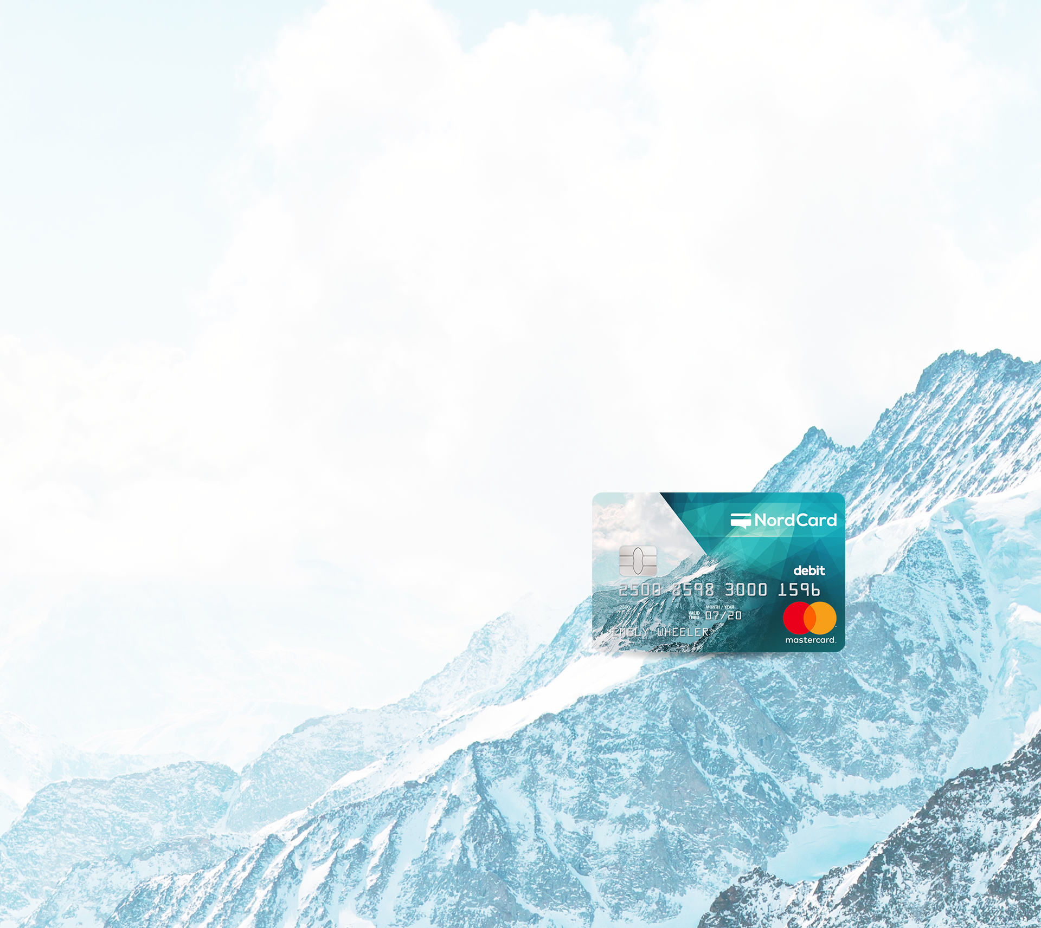
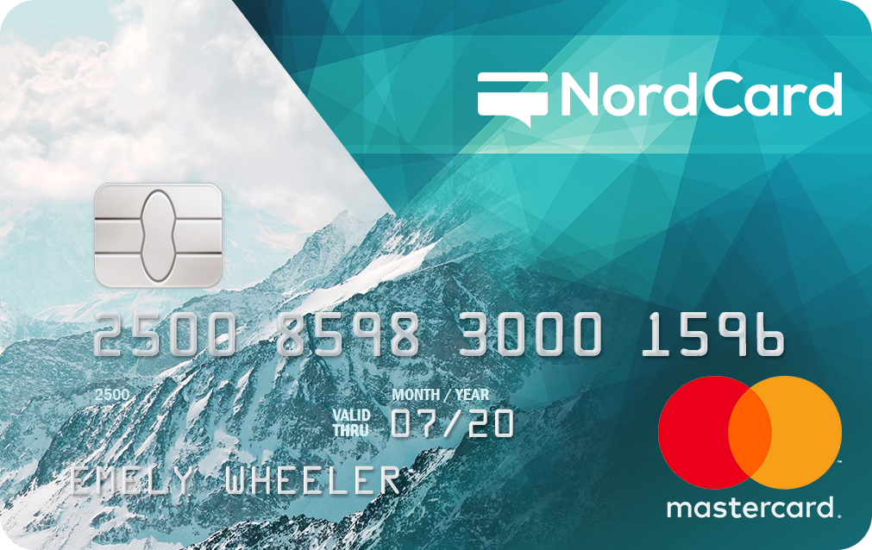
NordCard Creditlimit
Apply for NordCard Creditlimit just once but use it when and as often as you want. Open up new opportunities with NordCard!
Creditline up to 5 000 EUR
Repayment term up to 60 months
Payment card
Flexible repayment options
Online Banking system
Individual scoring process and unique offers
NordCard Creditlimit Is Always by Your Side
Keep track of your card transactions in Online Banking system
Receive your card free of charge by post
Withdraw money from ATMs and pay around the world
Shop online safely

Slide 5

How Our Clients Apply
1
Fill in our simple one-step application form
Less than 15-field online-application form makes the application
process very easy, transparent and fast
Customers choose us because we are:
RELIABLE 108 700
People chose NordCard
PROFESSIONAL 200
Answered questions per day
EASY 1.5 min
To fill in an application form
EFFECTIVE 97%
Answers provided within the first minute of a conversation with a consultant
Mandatory Requirements:
Customers in the 18-75-year-old age group
Official net income starting from 270 EUR per month
Personal bank account in one of the banks of Latvia
Declared address in the Republic of Latvia
2
Confirm registration
Transfer of 0.01 EUR from private bank account to the NordCard bank account assures the required level of Online identification
3
Get scored and get a loan
We make quick yet profound processing of applications and
scoring of each new customer, making AML/KYC, Income/Spendings, Credit History/Debt and other important checks

Slide 6

Customer Profile
Product Statistics
Female 44% / Male 56%
Average age 39
Average income 790 EUR
3 most popular industries
  Manufacturing
  Retail and wholesale
  Government
Higher education 47 %
NordCard payment card 20 %
Average Creditlimit amount 900 EUR
Utilization rate 77%
Average repayment age 700 days
One-time loan 60% / Constant creditline use 40%
Debt rate 15%
Default rate 5%
3 most popular spending categories
  Consumer goods
  Home repair
  Car purchase or repair

Slide 7

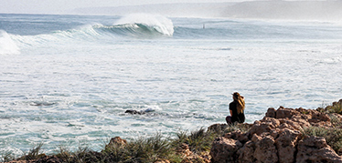

How Our Clients Use the Product
As a short-term loan
As money reserves
As a long-term loan
Suited for people who want to borrow in the short term. It is advantageous, fast, and don’t charge a loan extension fee
Use a credit line like money reserves that are always available to cover both unexpected and desired spending
There is always an option of repaying the loan over a longer period, and thus benefit from flexible repayment options
Apply just once, but use when needed
Have benefits of interest-free period
Return in the long term and forget about paying extension fees
Apply now, but use when you want
Start to repay, only when start to use it
No fee for account opening and maintanance
Pay a loan within 60 month
Divide repayment in smaller parts
With each payment interest gets smaller

Slide 8
Business Model
mastercard
payments all over the world
ATM cash withdrawals
secure online payments
payment card
self service
invocing
account statement
communication
profile settings
payments
notification settings
paid-service administration
brand
marketing & SEO
online applications
FAQ
online
banking
web
NordCard
technology driven approach
extensive automation
“All-in-Online” principle
fully integrated infrastructure
FinTech
customer service
applications (AML, KYC, scoring)
professional customer service
debt collection

Slide 9
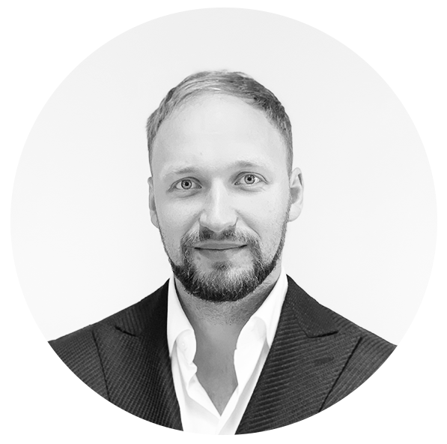
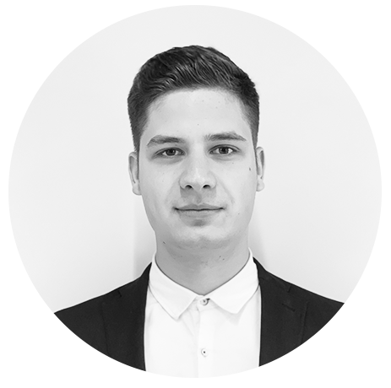
Management Team
Executive manager with
varied experience in
business development, finance, economics, jurisprudence, IT and operations management.
M.Econ. from the University of Latvia
B.Fin.Eng. from Riga Technical University
economics lecturer
CAMS certified
Business entrepreneur with over 10 years experience in
business management and varied experience in strategic planning, finance and operations in the banking and brokerage industry.
M.Fin.M. from the School of Business and Finance
B.Fin from the School of Business and Finance
Andrejs Saricevs
Board Member
Daniels Jukna
CEO

Slide 10
Organizational Structure
Board
CEO
CEO
CIO
CFO
Debt Collection Department
Legal Department
Office and HR Department
Customer Service Department
IT Department
Marketing Department
Accountancy Department

Slide 11
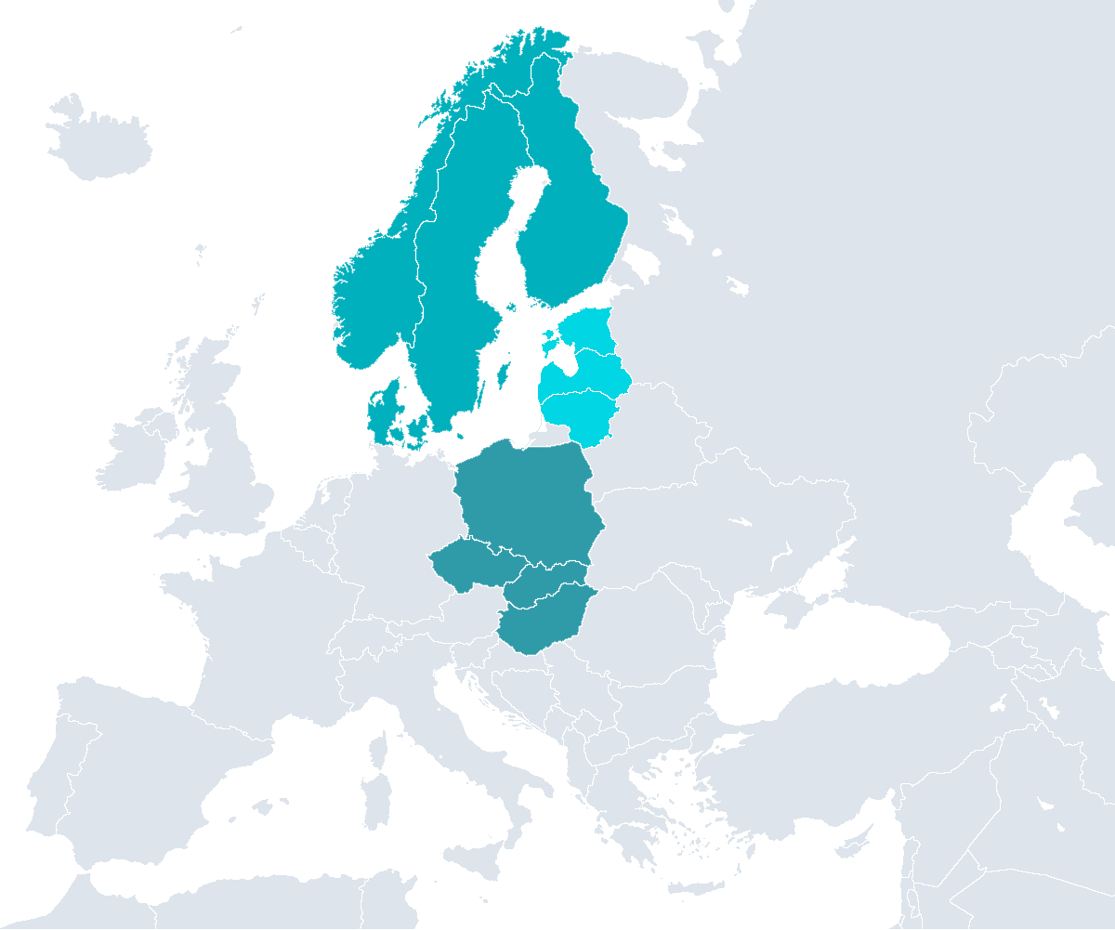
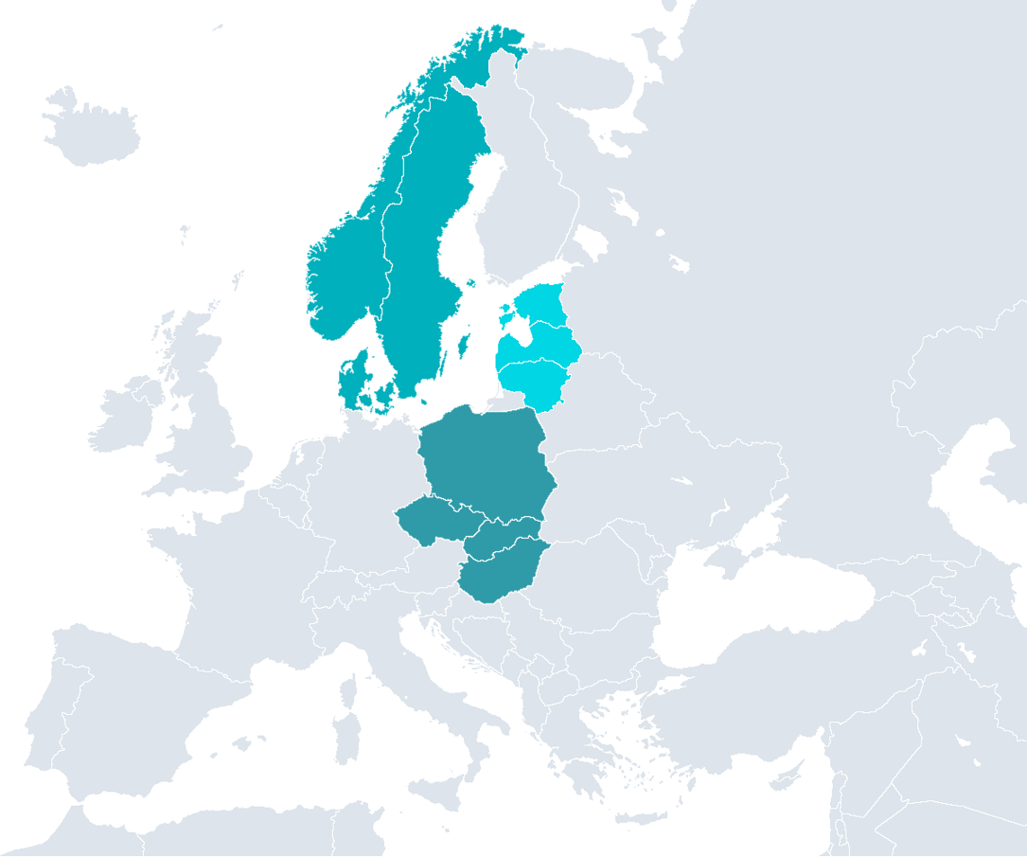
Future Scale Up
Scandinavia
Population 21m
Neobanking is simple
Expand business to other EU countries
Product with core banking services
Mobile APP
3m clients
1m payment cards
Infrastructure scale up and maximum automation
Baltics
Population 6m
Visegrád Four
Population 64m

Slide 12
Timeline
2017Q2
New product «Credit limit to account"
2016Q3
First NordCard card issued
2019Q3
New Online Banking system
2020Q3
New marketing channels
2021Q2
Joining Bondster platform
2017Q1
Great marketing campaign (TV, radio, internet)
2018Q2
Great improvement of scoring and debt collection processes
2019Q2
Introduction of new and more functional card
2016Q2
License obtained
2020Q1
Joining Iuvo platform
2020Q4
New product «Refinancing"
2016
2017
2018
2019
2020
2021
Gross total debt
350k
1.8m
2.2m
2.3m
2.2m
2.8m
Accumulated credit limit
350k
1.5m
1.7m
1.7m
1.7m
2.3m
2020Q1
Audit
2021Q1
Audit

Slide 13
Timeline
2023Q3
Joining another platform
2022Q3
Lenders
2025Q3
New market
2023Q2
Joining Decamel
2024Q3
Joining Mintos
2025Q2
New market
2022Q2
Payment automatization
2022
2023
2024
2025
Gross total debt
3.5m
5m
6.5m
10m
Accumulated credit limit
2.8m
4m
5.2m
7m
2021Q1
Audit
2022Q1
Audit
2023Q1
Audit
2024Q1
Audit

Slide 14
Hedge Capital Company LLC
Gustava Zemgala gatve 74A, Riga, LV-1039, Latvia
e-mail: info@nordcard.eu
phone: 00 371 62004400
www.nordcard.eu

